Slide 1


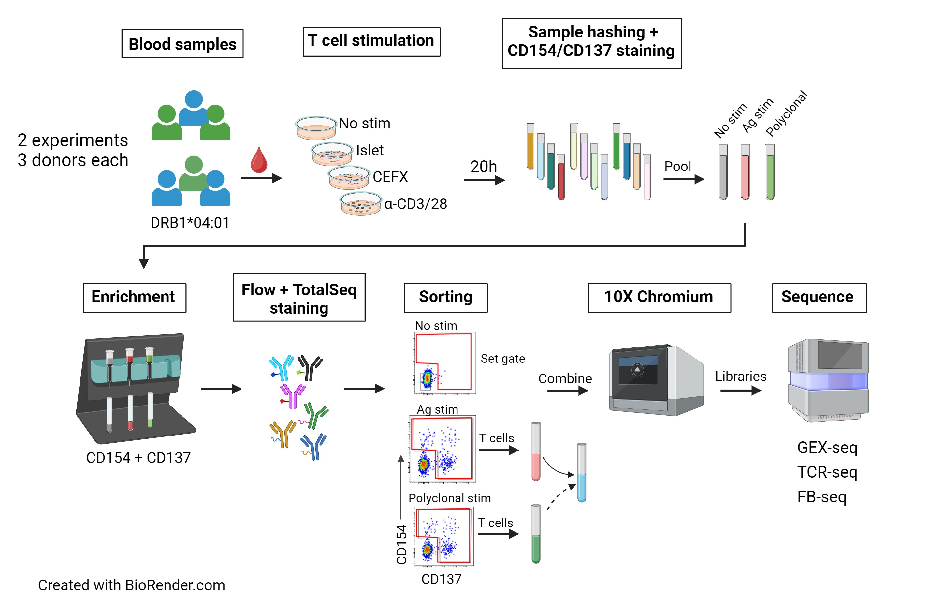
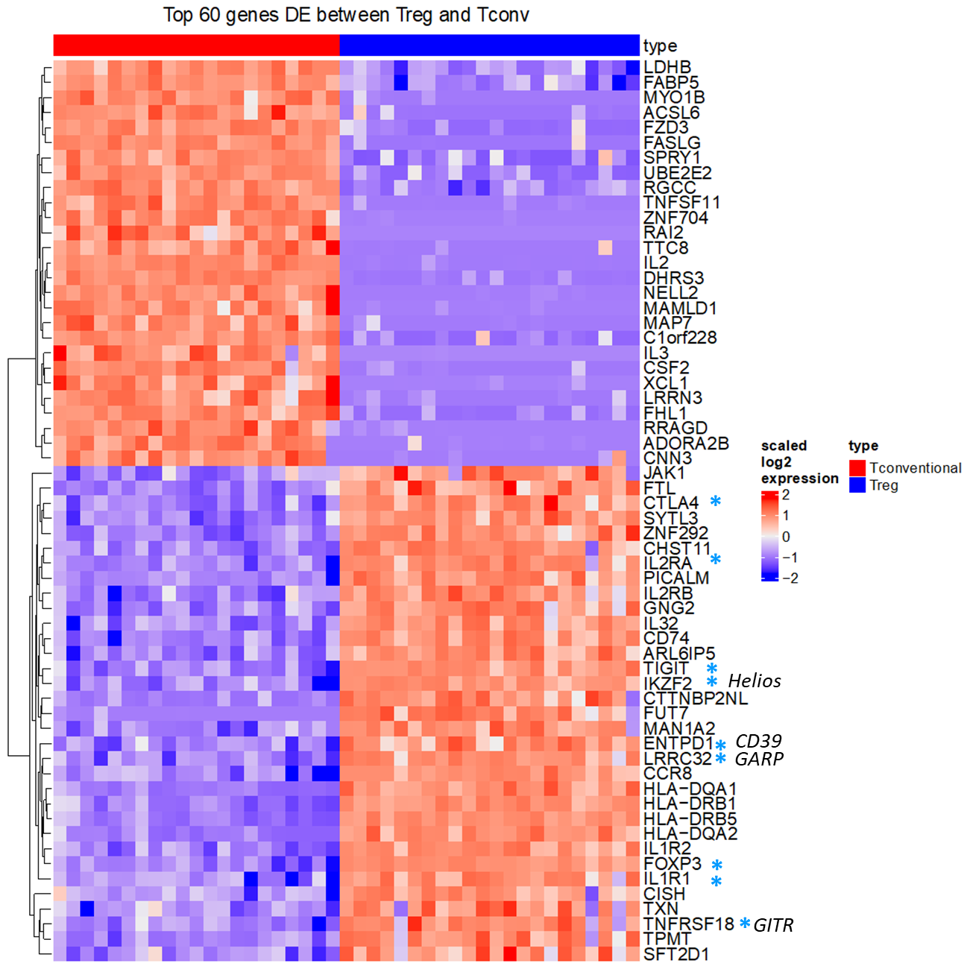
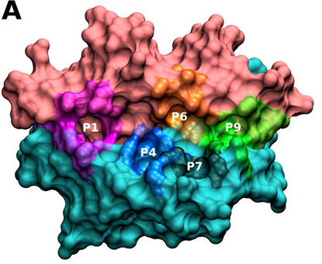
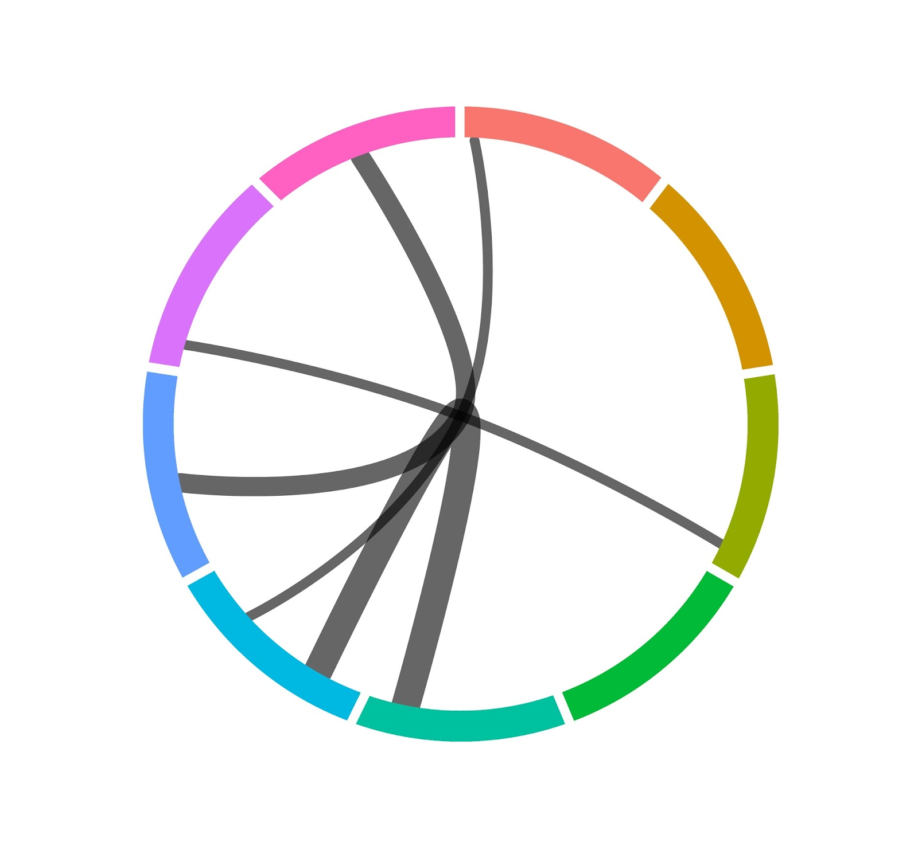
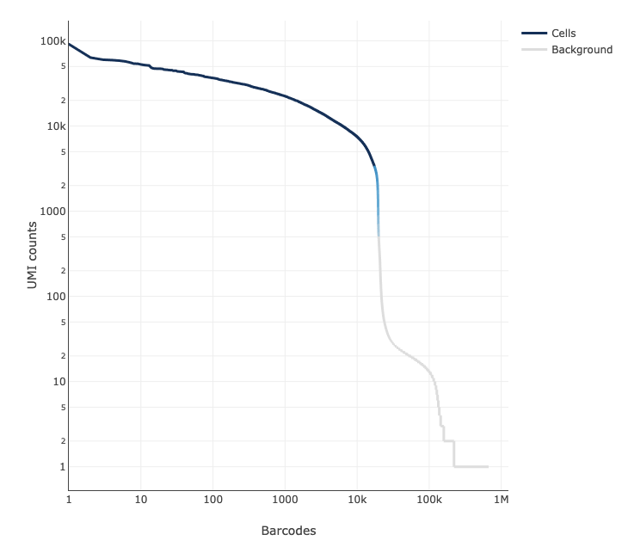
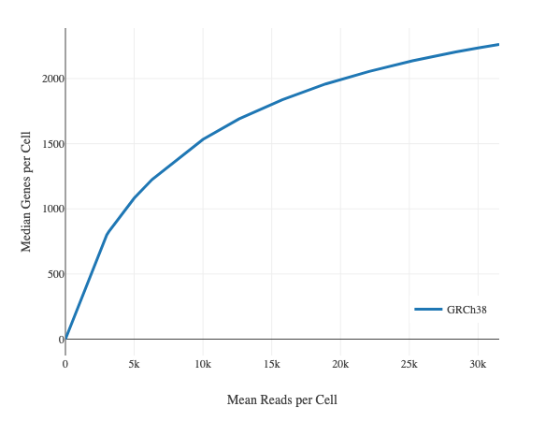
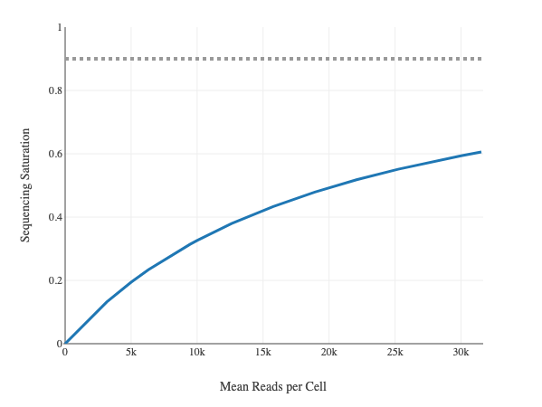
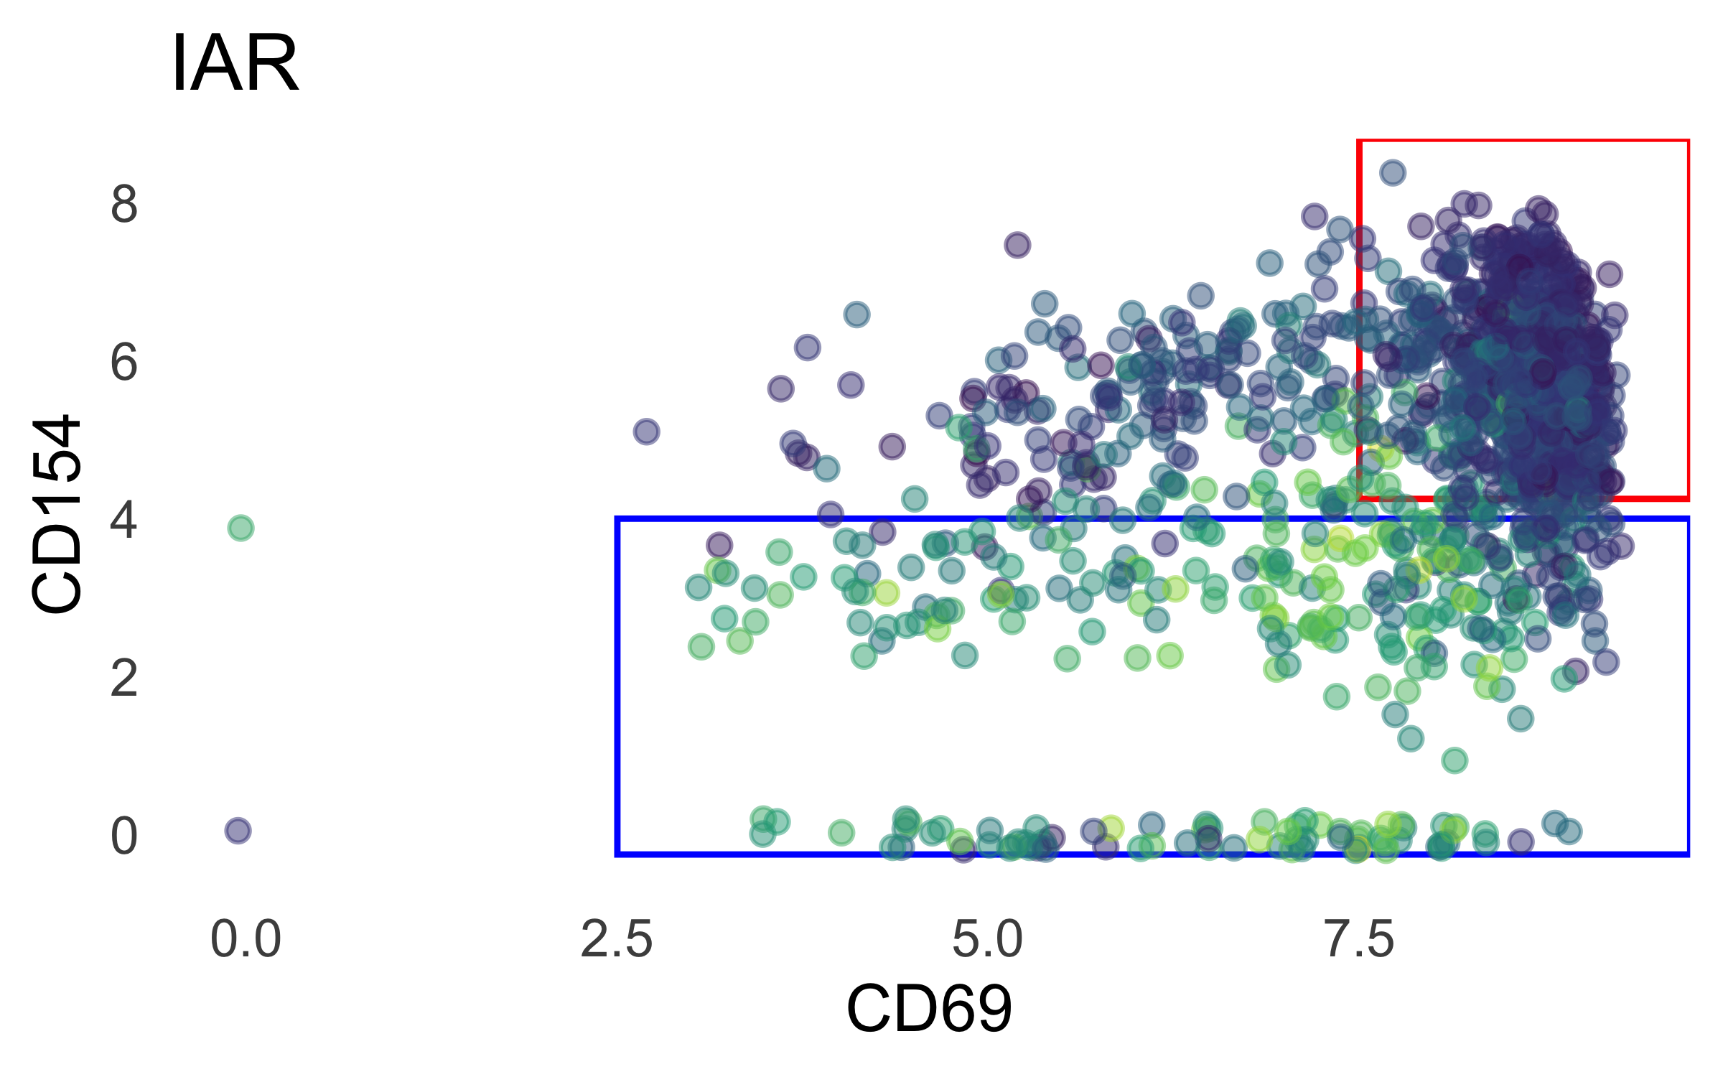
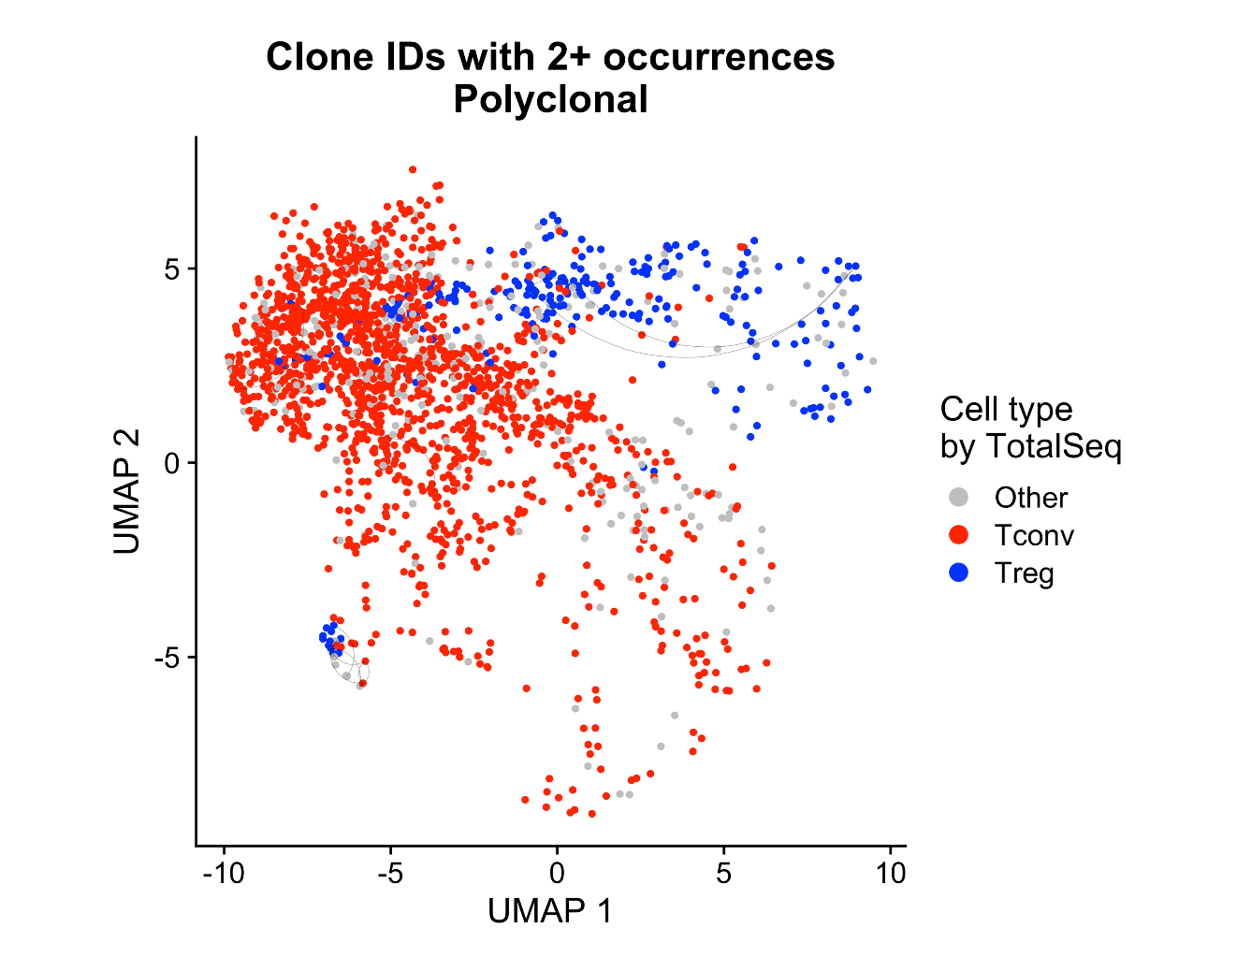
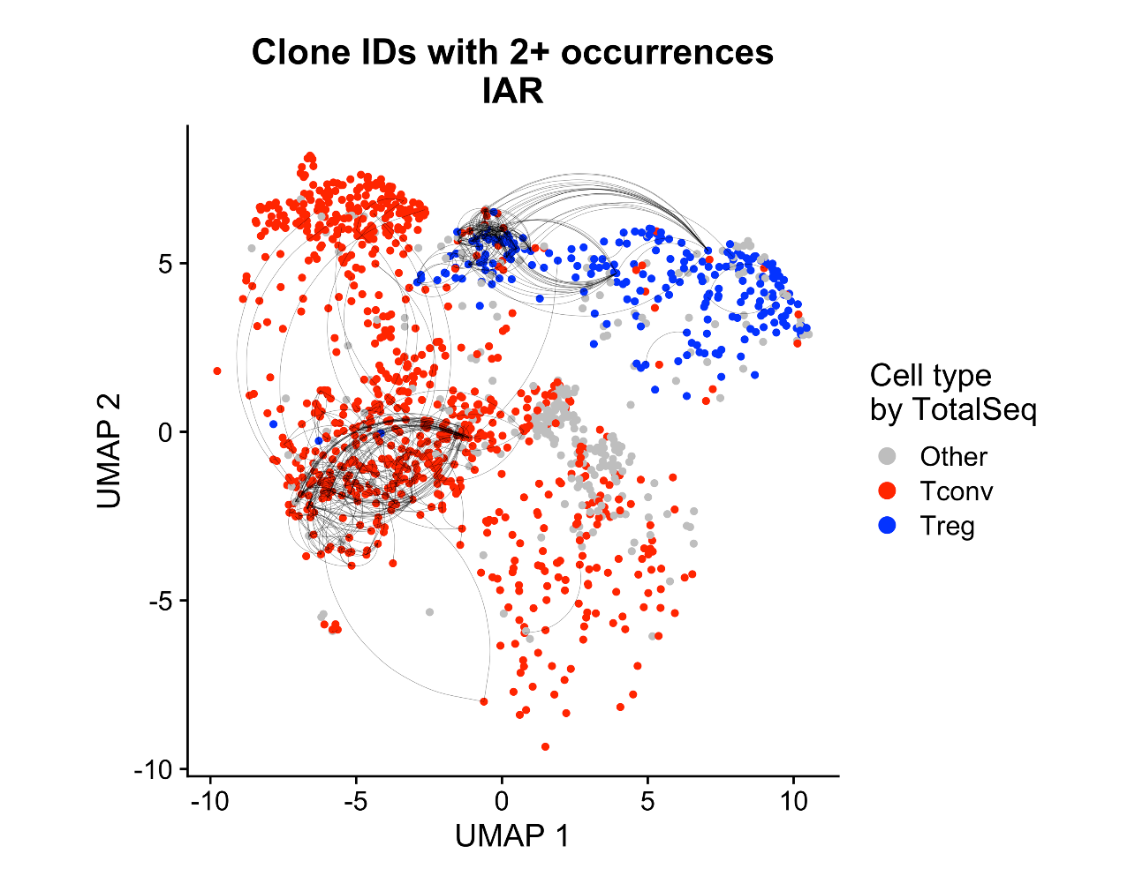
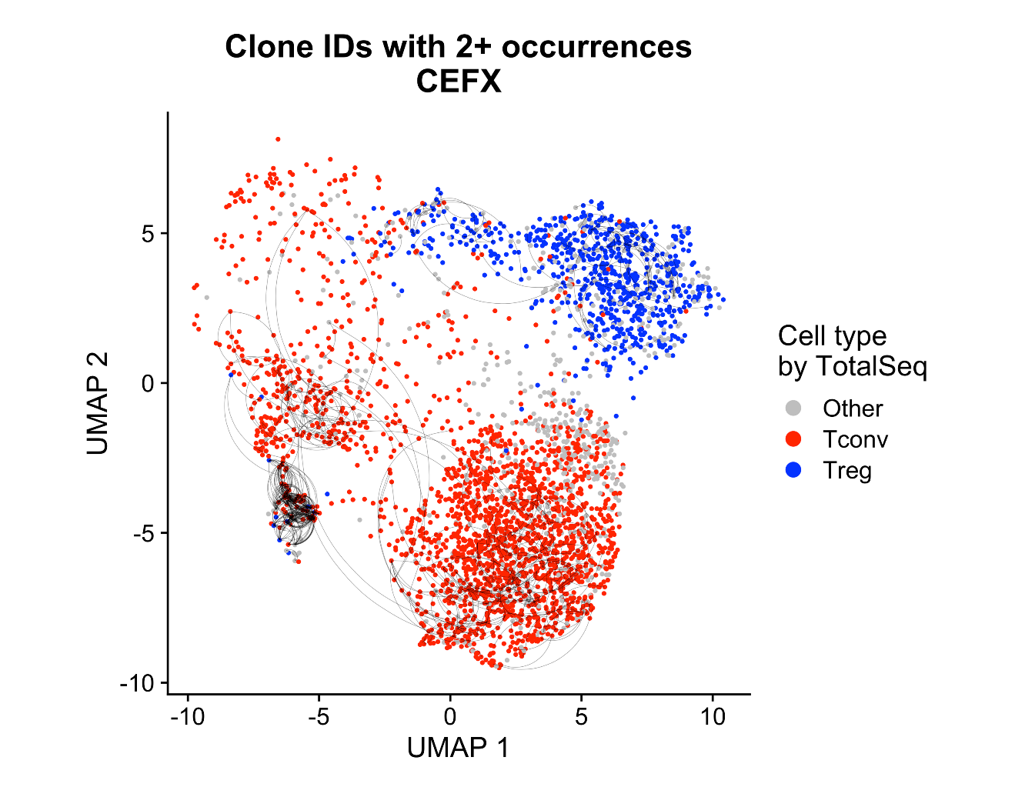
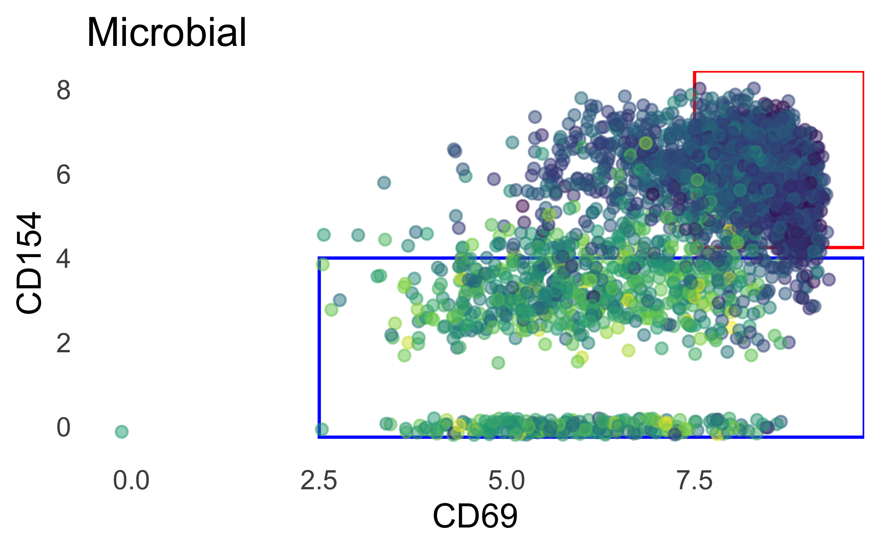
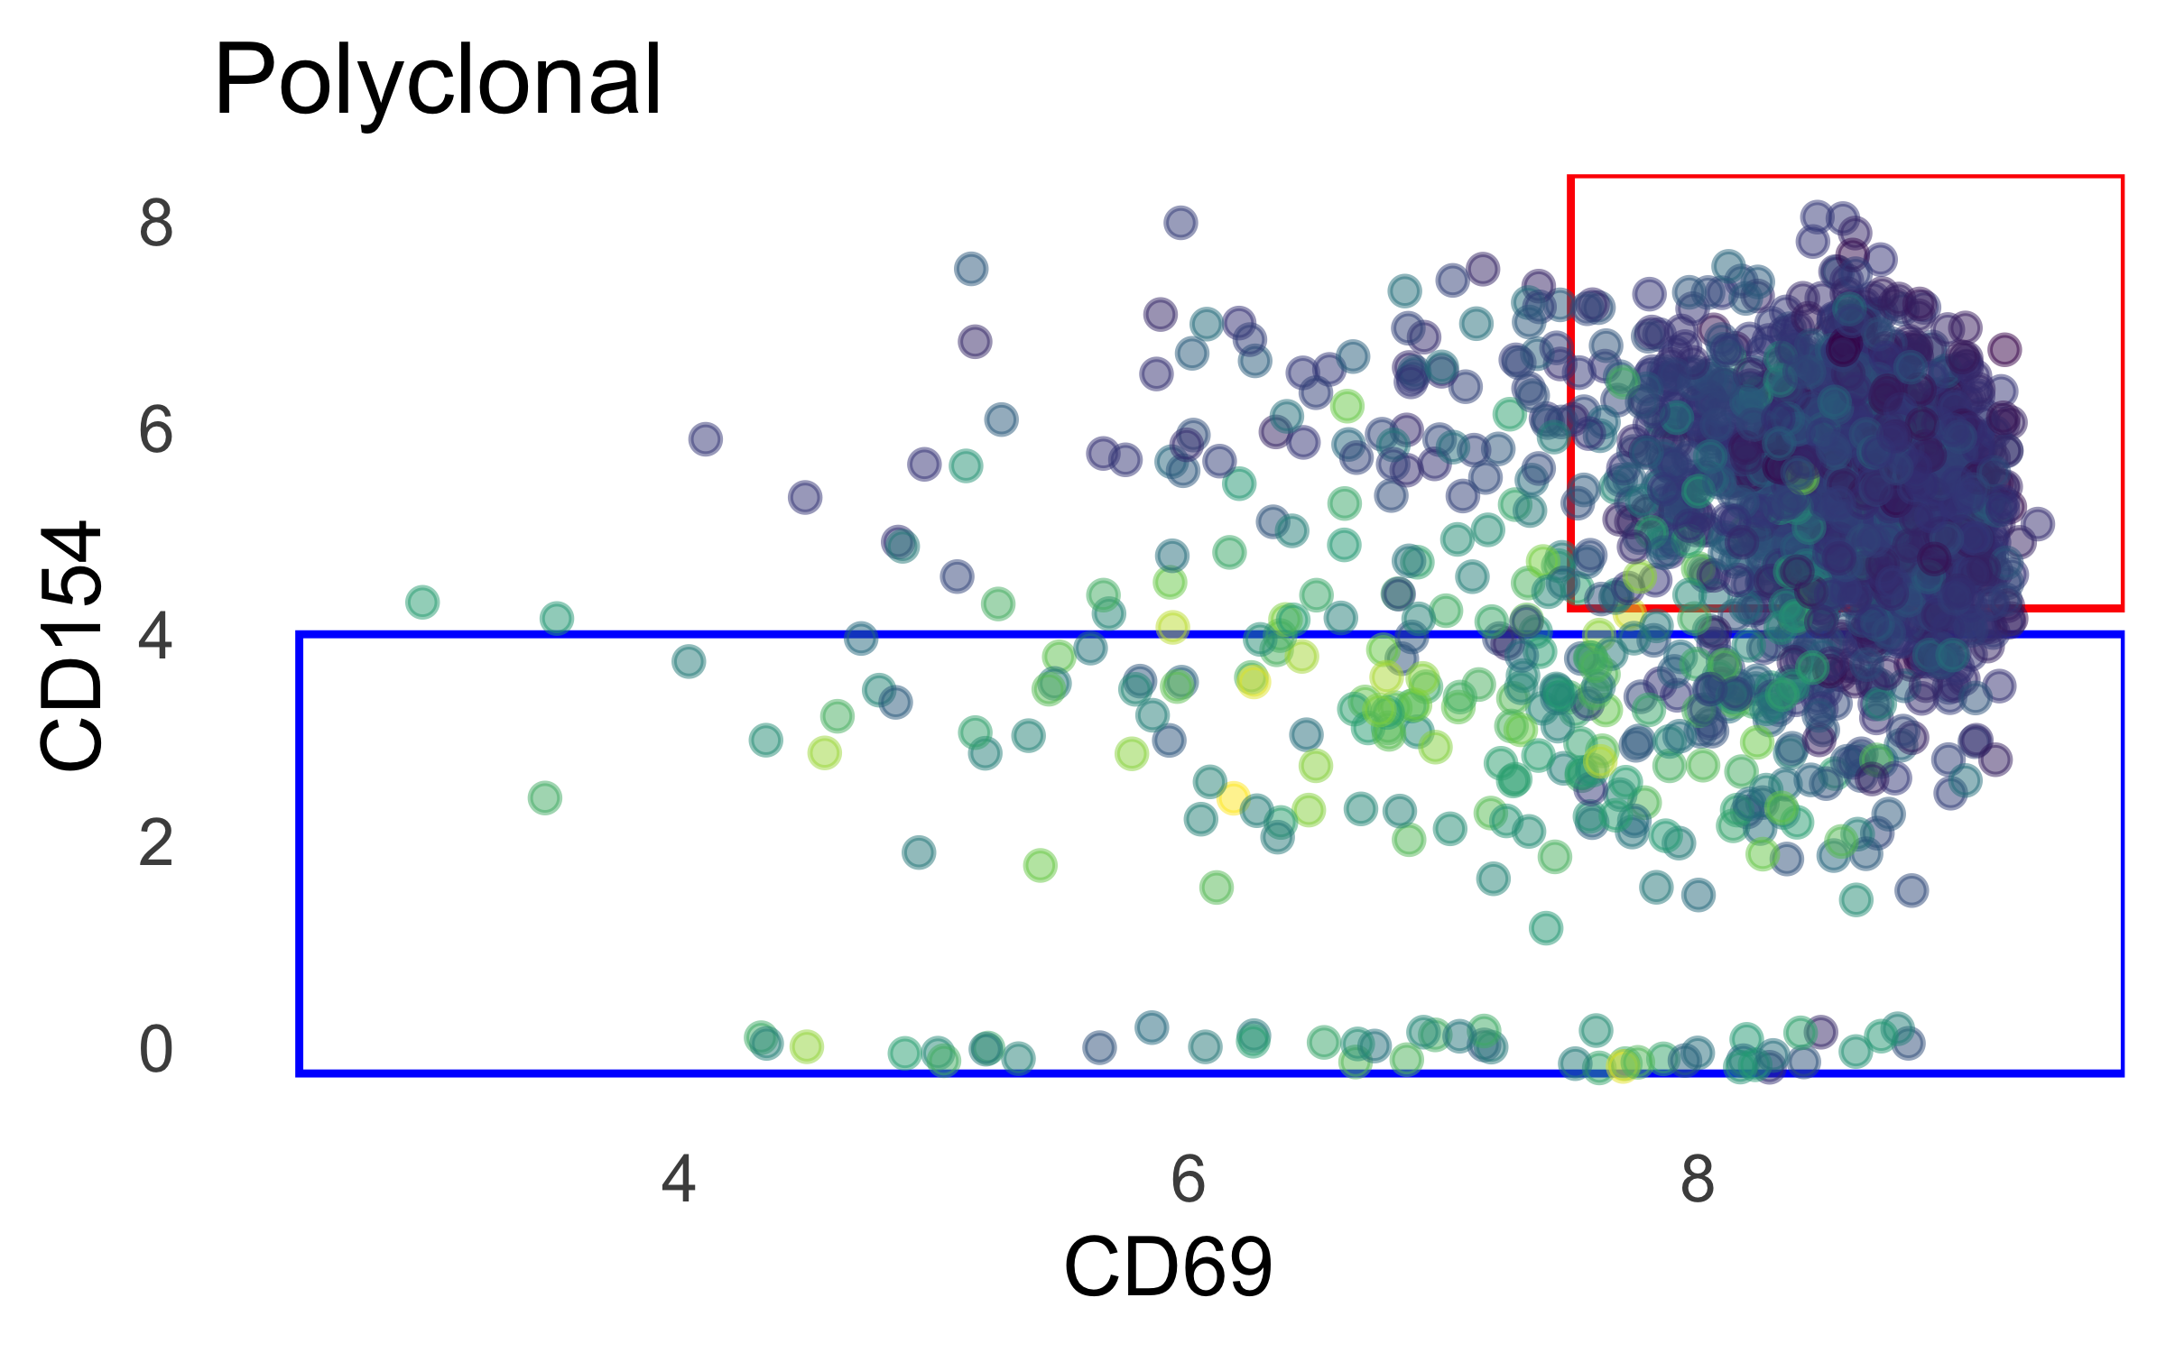
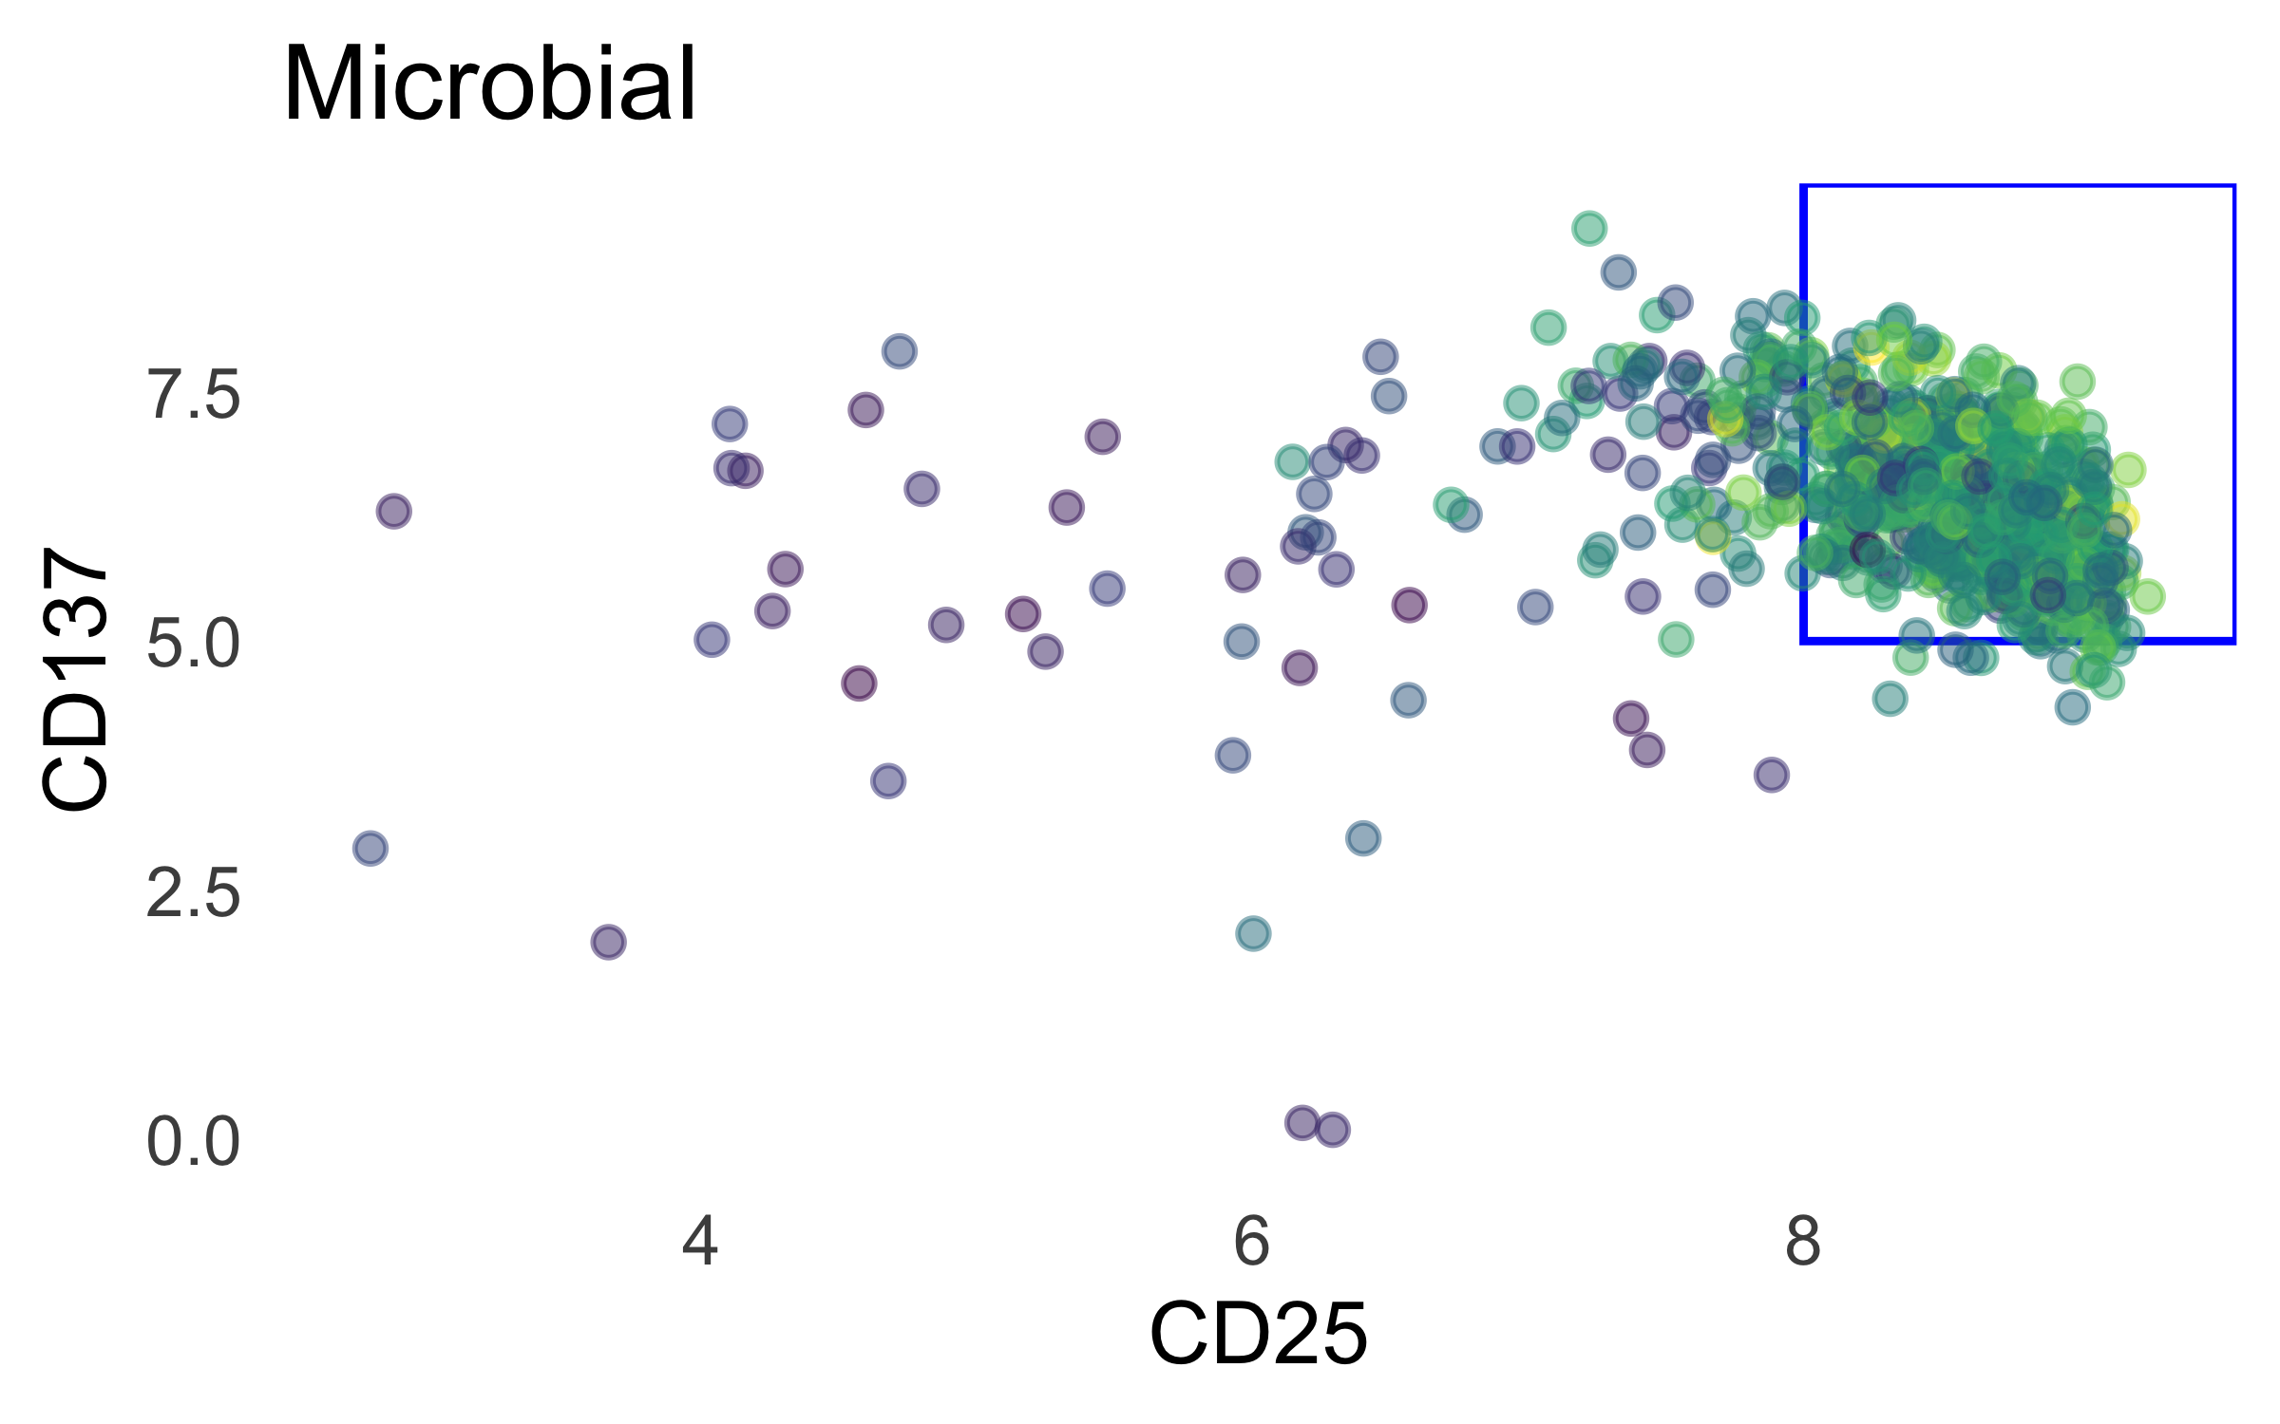
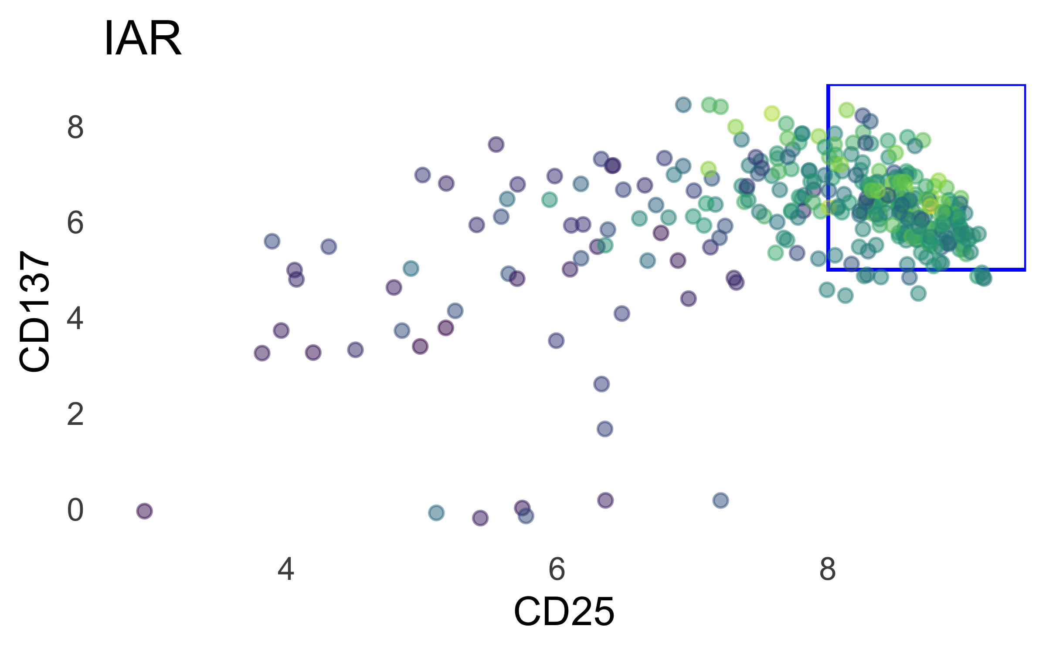
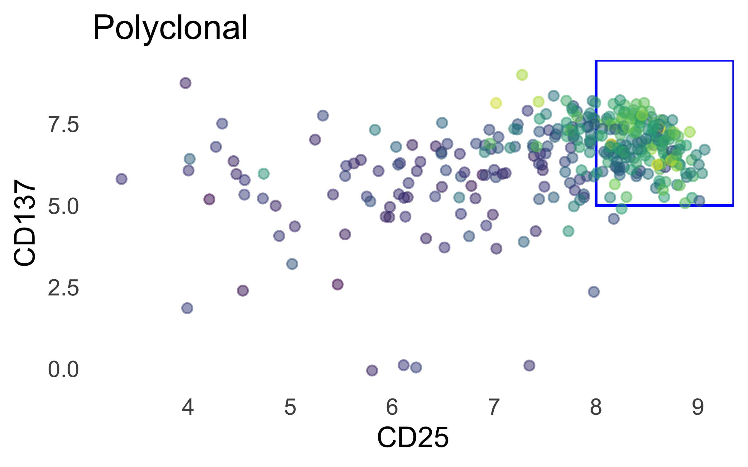
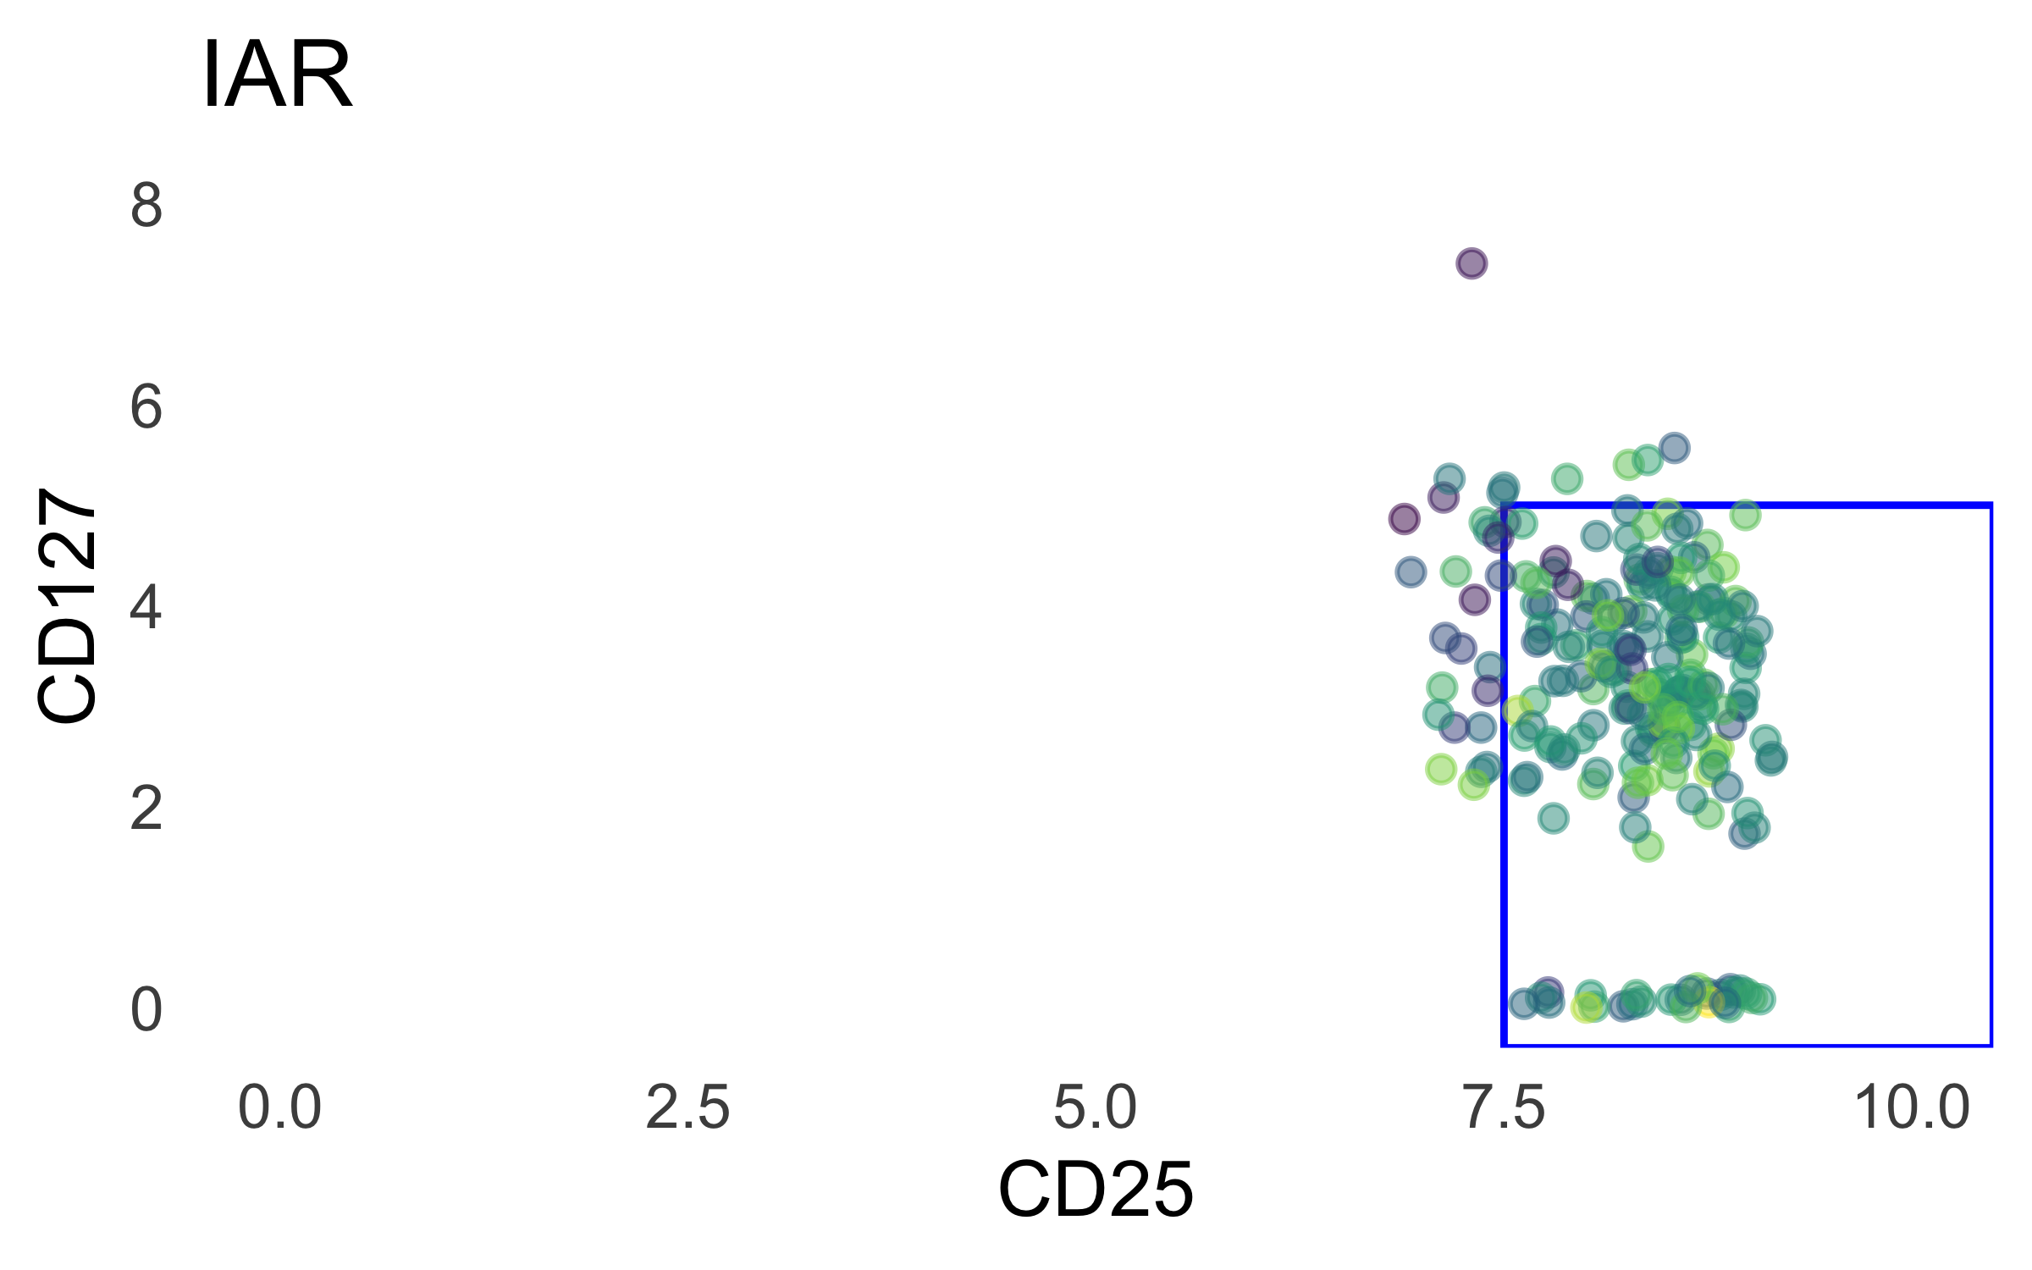
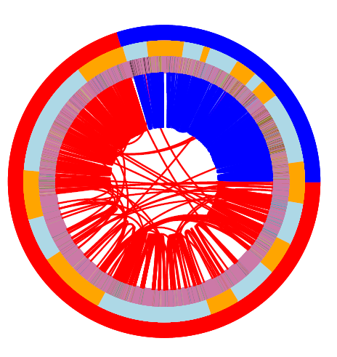
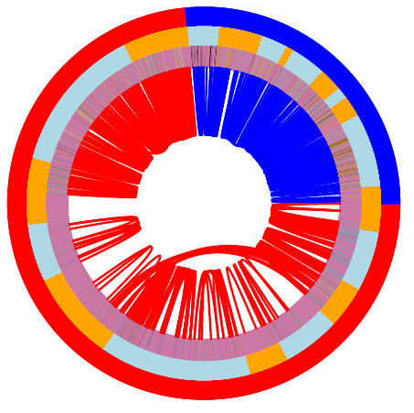
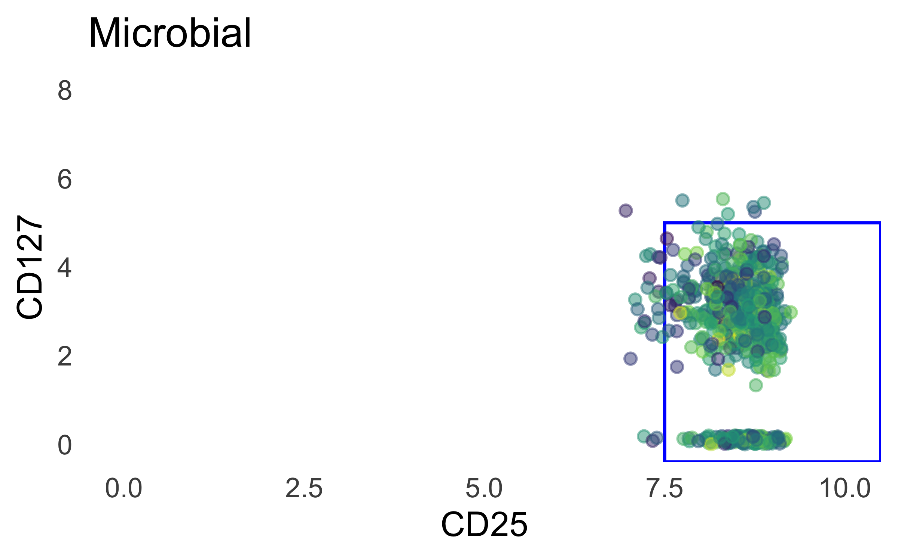
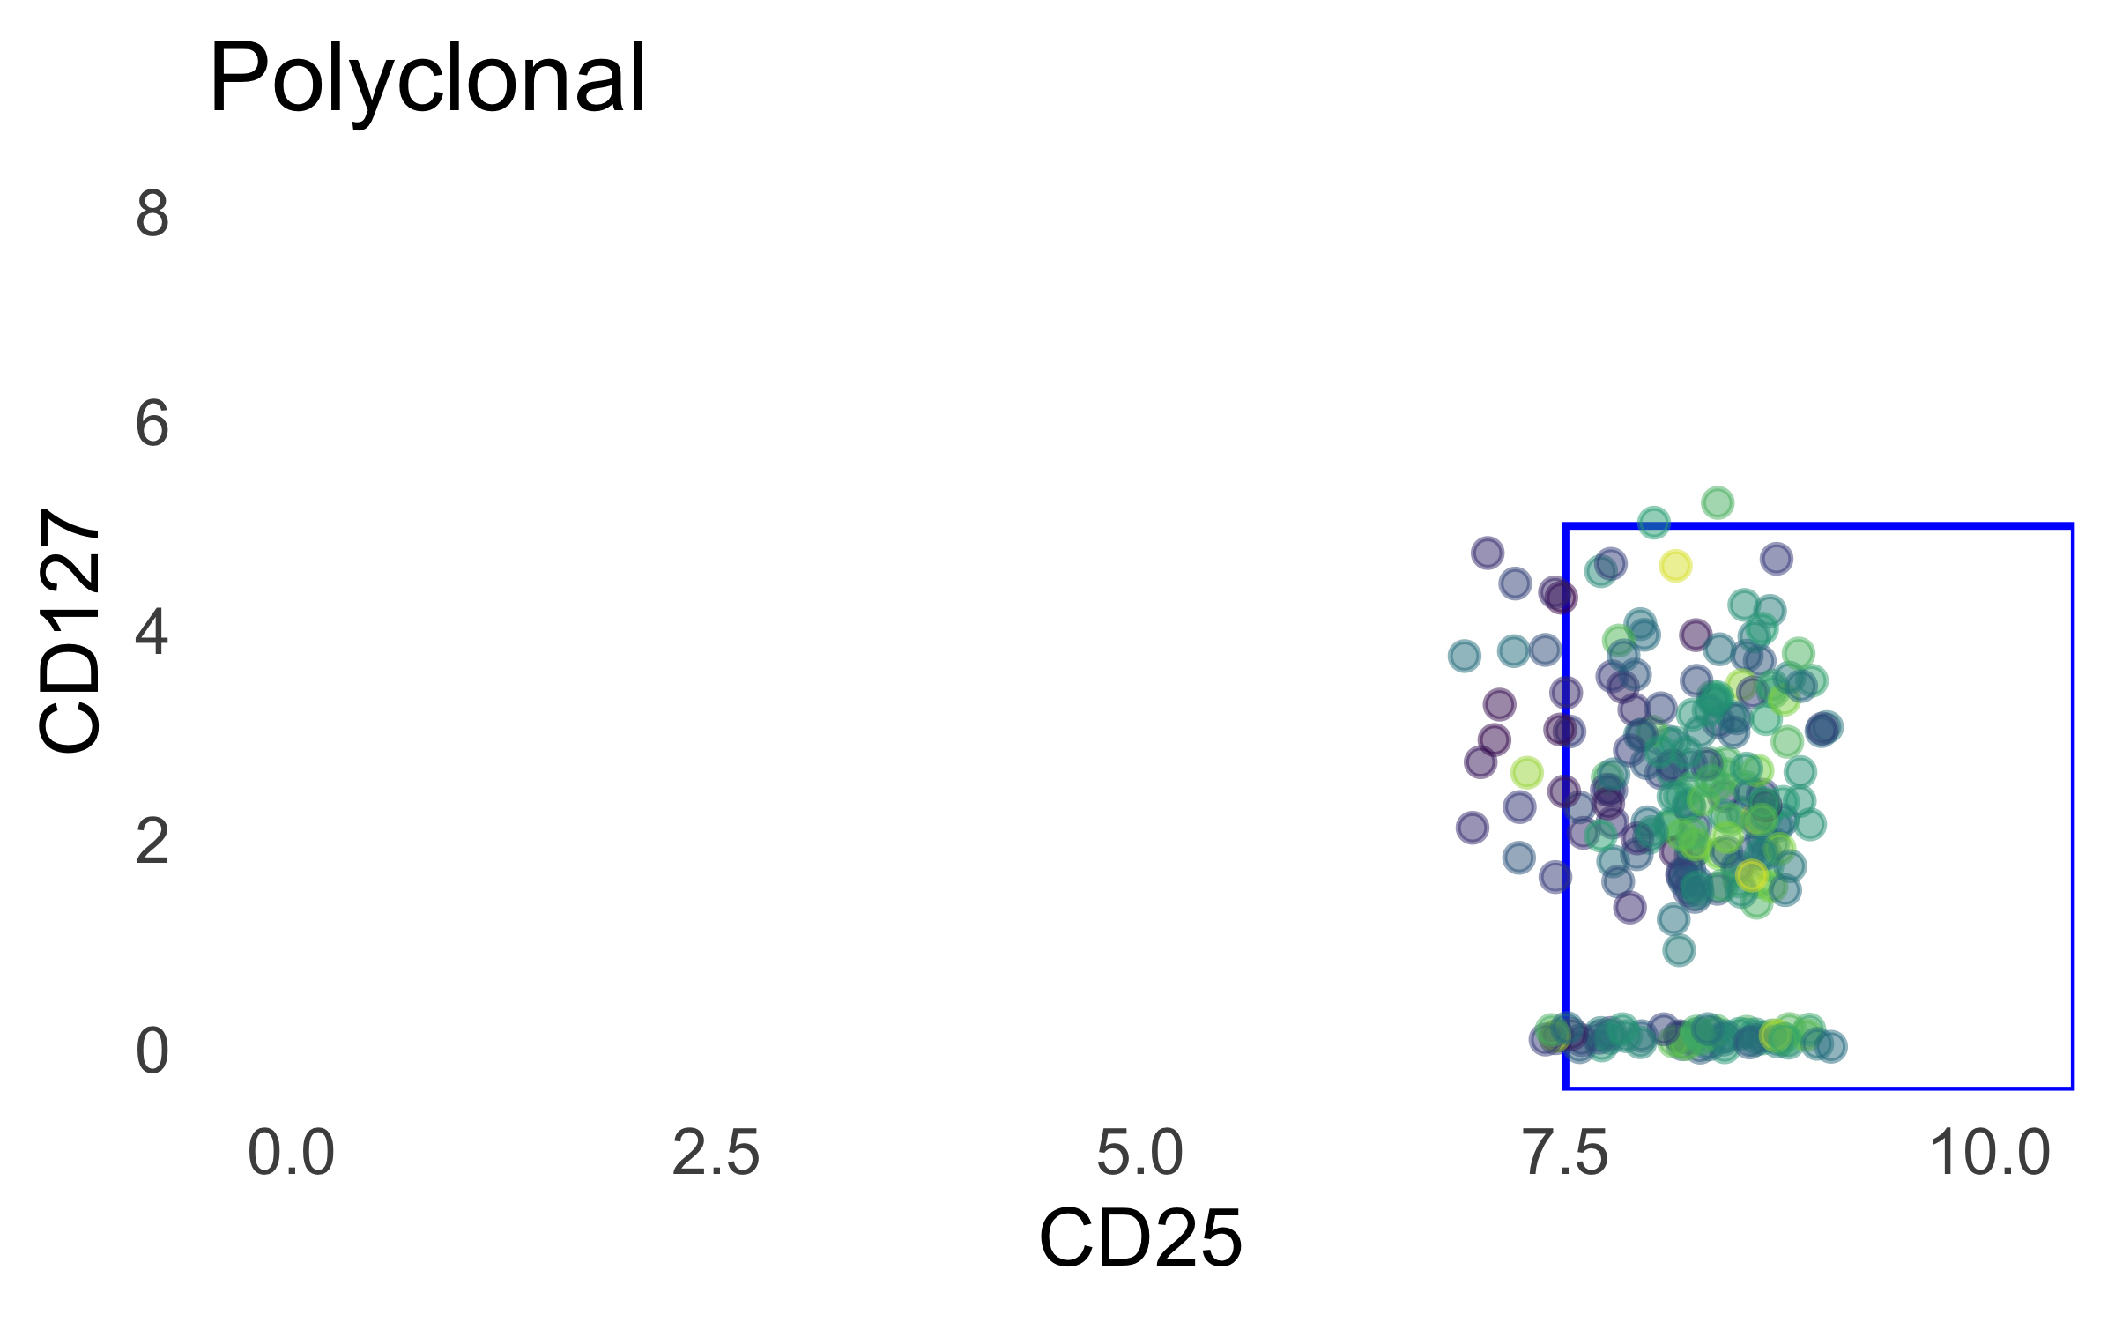
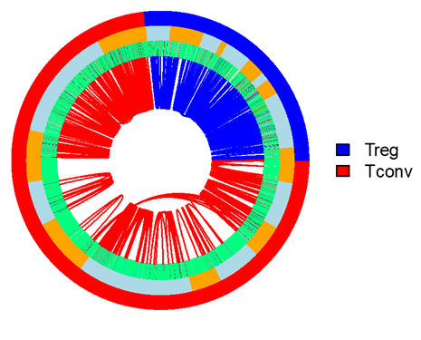
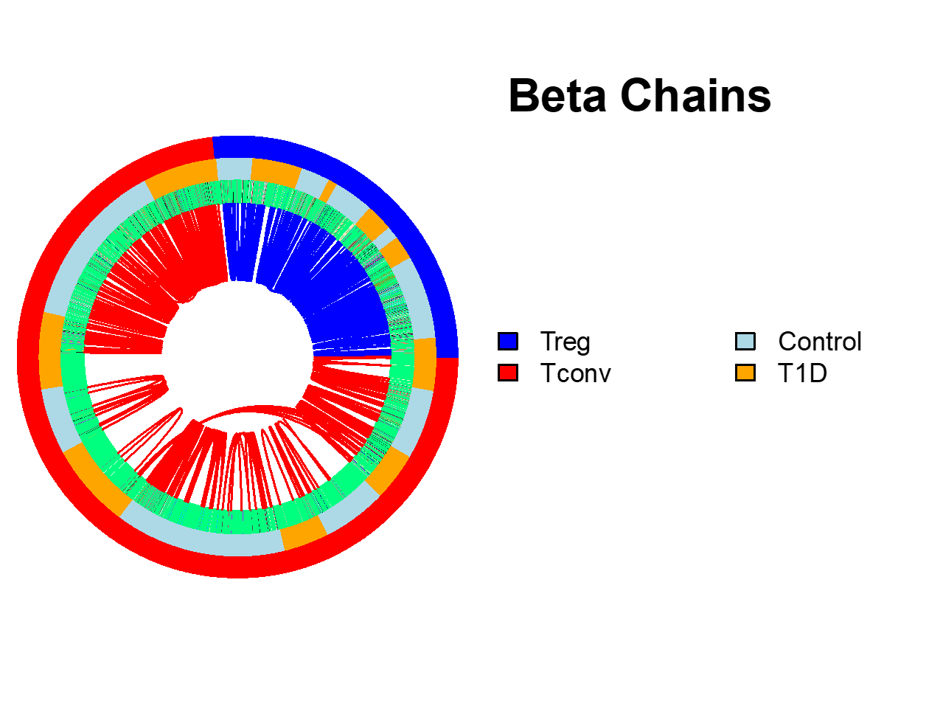

Foreign and autoreactive cd4 conventional and regulatory t cells in t1d and healthy subjects
Thomas H. Edwards^{2*}, Janice Chen^{1*}, Alex Hu², Vivian Gersuk², David J. Rawlings³, Jane Buckner¹, Karen Cerosaletti¹
Centers for ¹Translational and ²Systems Immunology, Benaroya Research Institute, Seattle WA;
³Seattle Children Research Institute; *Co-1st authors
Summary
2. scRNAseq processing
Objective:
Characterize the features of islet autoreactive CD4 regulatory T cells (Tregs) in type 1 diabetes (T1D) compared to islet CD4 conventional T cells (Tconv) in the context of foreign antigen-reactive T cells.
Approach:
Peripheral whole blood from cross sectional cohorts of established T1D subjects and matched non-diabetic healthy controls carrying the high-risk class II DRB1*0401 allele.
Isolated islet and foreign reactive CD4 Treg and Tconv cells using a CD154-CD137 activation induced marker (AIM) assay by single cell sorting followed by single cell RNA-sequencing utilizing 10X Chromium 5’ GEX/TCR/FB with Illumina P4 XLEAP.
Analyzed the transcriptomic and TCR profiles of foreign and islet reactive CD4 Tregs and Tconv cells in T1D donors compared with control donors.
Results:
Multiple samples can be prepared in one day, hashtagged, and combined
10X cell capture was poor, 35%, but chip was loaded on high end (50K)
We were able to test multiple stimulations
Polyclonal stimulated CD4 works well as a landscape of all CD4 T cells as they co-cluster with AIM stimulated cells
Ag specific but not polyclonal stimulated T cells show clonal expansion
Little TCR sharing between Tconv and Treg cells
Conclusion:
Islet autoreactive CD4 Tregs are less frequent than islet Tconv cells in T1D donors and are expanded consistent with antigen experience in vivo.
1. Optimize RNA clusters with consensus of unsupervised metrics
Davies-Bouldin Index
Maximize pairwise inter-cluster distances and minimize intra-cluster variances
Calinksi-Harabasz Index
Maximize inter-cluster variance and minimize intra-cluster variances.
Median Silhouette Score
Minimize intra-cluster distances and maximize distances to nearest cluster.
2. Optimize 2D UMAP embedding with scDEED
Cells should have the same neighbors in 2D and ND
UMAP embedding trustworthiness
3
5
2
Approach
1
4
UMAP 2
A. Study donors
6
0
Group | No. subjects | M:F | Age (median, range) | Disease duration (median, range) | HLA class II
T1D | 3 | 1 : 2 | 33 y (24-43) | 14.4 y (13.4-32.7) | DRB1*0401
Control | 3 | 2 : 1 | 28 y (25-72) | -- | DRB1*0401
UMAP 1
B. Single cell sequencing pipeline
Xia, L., Lee, C. & Li, J.J. Statistical method scDEED for detecting dubious 2D single-cell embeddings and optimizing t-SNE and UMAP hyperparameters. Nat Commun 15, 1753 (2024). https://doi.org/10.1038/s41467-024-45891-y
3. scRNAseq results
3
5
2
3
5
2
3
5
2
1
4
1
4
1
4
6
0
6
0
6
0
All clusters have all donors and both studygroups
Most clusters contain appreciable cells of all specificities except 0, which is almost all microbial (foreign antigen-reactive).
IAR T cells present in every cluster.
Polyclonal Ab creates a suitable background landscape.
Clusters 6 and 3 are dominated by a few control donors.
Make a stepwise/flowchart setup 1. Treg/Tconv 2. Ag-specific cells OR consider splitting 2 into another section
4. Identification of regulatory and conventional Ag-specific T cells
C. Single cell analysis scheme
Cell calling
-FB ‘gating’
-RNA signature
-CellTypist
Treg + Tconv characterization
-TCR repertoires
-DGE
3
5
2
3
5
2
3
5
2
Hashtag demultiplexing
TCR accounting
scRNAseq processing
UMAP 2
1
4
1
4
1
4
6
0
6
0
6
0
UMAP 1
5. Both islet- and CEFX-specific Tregs/Tconvs are expanded, but share few TCR sequences
UMAP 2
3
5
2
3
5
2
3
5
2
We reproduce prior IAR findings
FAR cells appear similar to IAR (remove IAR/FAR acronym)
1. New sequencing technology successfully applied to AIM assay
1
4
1
4
1
4
Update celltype identification
A. Cell Ranger QC
6
0
6
0
6
0
CD3/28
Islet
CEFX
8,117 Median UMI counts/cell
UMAP 1
Make stimulation-facet ordering uniform
UMI counts
Median genes/cell
2,310 median genes/cell
Sequencing saturation
37,420 cells recovered / 106K loaded between 2 batches (35%)
24,244 total genes
Barcodes
Mean reads/cell
Mean reads/cell
Make p589-1 circos
Maybe do not need circos from P390 if no p589-1 circos
B. Hashtag Demultiplexing
4 Control IAR
Islet autoreactive Tconv and Tregs are expanded within donors consistent with in vivo ag experience.
Tconv and Treg share TRA chains between donors.
Few TCR chains are shared between Tconv and Tregs.
4 Control Polyclonal
4 Control Microbial
4 Control IAR
6 T1D IAR
TRA chains
TRB chains
6 T1D Microbial
2 T1D Polyclonal
2 T1D Microbial
2 T1D IAR
6 T1D Polyclonal
5 T1D IAR
5 T1D Microbial
5 T1D Polyclonal
4 Control IAR
4 Control Microbial
4 Control Polyclonal
6 T1D Polyclonal
6 T1D Microbial
6 T1D IAR
3 Control IAR
3 Control Microbial
3 Control Polyclonal
2 T1D IAR
2 T1D Microbial
2 T1D Polyclonal
1 Control IAR
How many cells of each specificity in each Ag-specific gate?
1 Control Microbial
Circos plots depict TCR chain sharing from all Treg and Tconv cells. The outer ring shows cell type, the middle ring represents group, and the inner ring is colored by TCR sequence. Lines connect individual cells sharing TCR chains. Sharing was defined as identical nucleotide sequence of TRA and TRB chains.
Cells identified per hashtag
1 Control Polyclonal
Add rest of gating figs
 | Microbial | IAR | Polyclonal
1_Control | 1422 | 112 | 42
2_T1D | 1869 | 153 | 160
3_Control | 3085 | 238 | 493
4_Control | 1327 | 386 | 602
5_T1D | 8342 | 240 | 275
6_T1D | 12384 | 244 | 436
C. TCR Recovery ~80%
Deal with boundary box under logo
Microbial cells downsampled to 600 per donor
Acknowledgements:
BRI Center for Interventional Immunology
BRI Genomics Core Laboratory
Center for Systems Immunology
Kim Varner | Heather White | Jodie Stroud | David Lee | Kassidy Benoscek Sandra Lord MD | Cate Speake PhD
Kimberly O’Brien | Quynh-Anh Nguyen Jeffry Yaplee | Vivian Gersuk PhD

